Slide 1
Epidemiological Modeling of the COVID-19 Epidemic in Santa Clara County
Preliminary Report
March 18, 2020

Slide 2
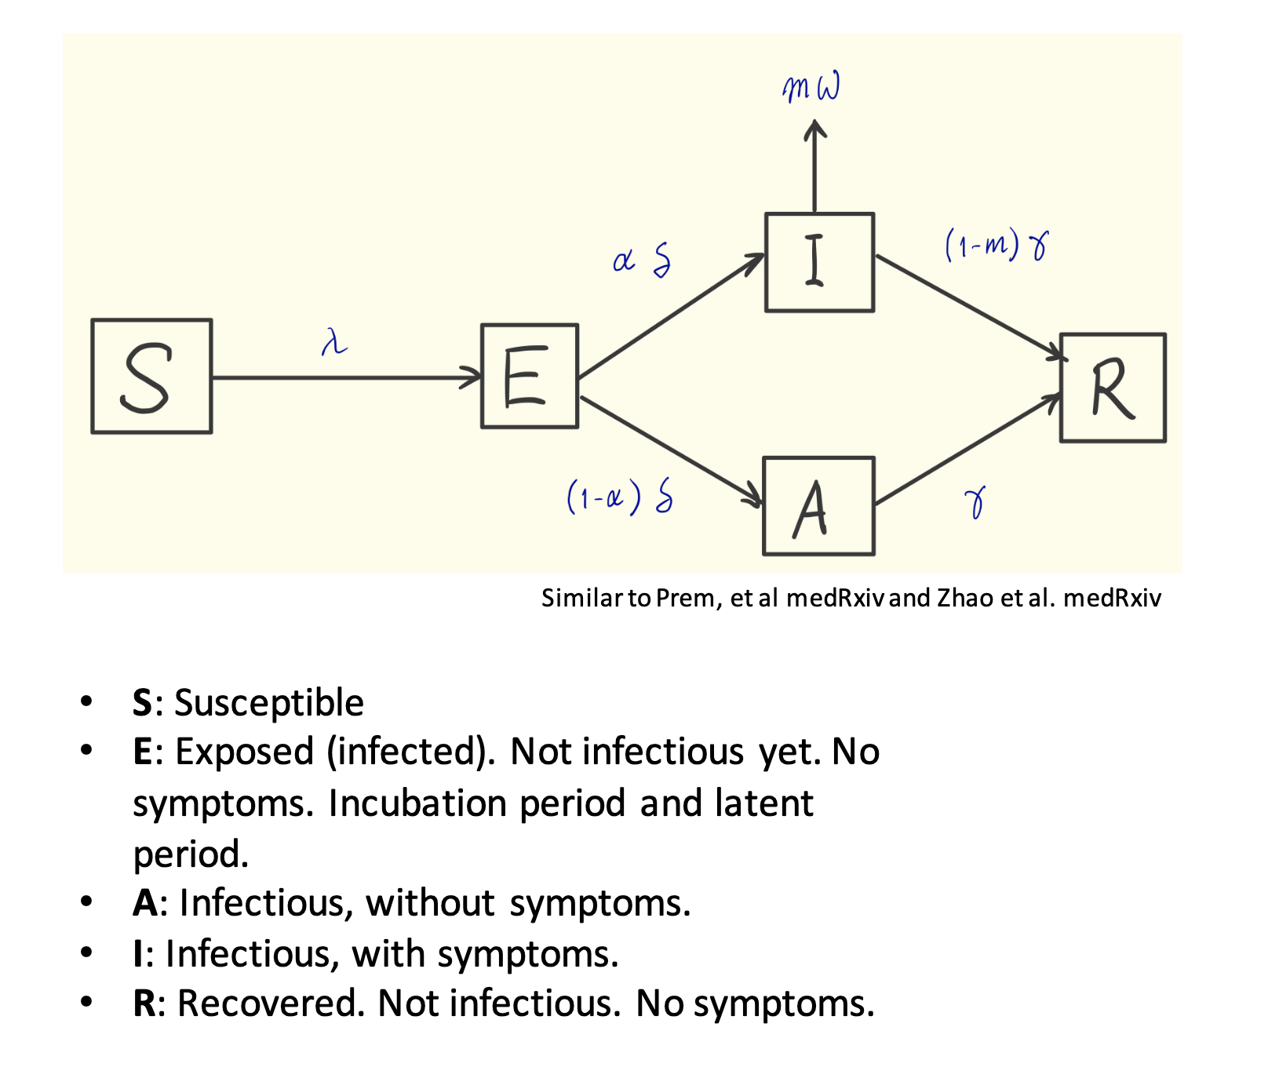
Model structure

Slide 3
Age stratification
Source: American Community Survey (2018)

Slide 4
Observed data fits to different models.
Assumptions
13% case ascertainment over March 1-March 15
Low transmission in asymptomatic individuals (RR = .25)
Children as susceptible as adults

Slide 5
Observed data fits to different models.
Assumptions
13% case ascertainment over March 1-March 15
Higher transmission in asymptomatic individuals (RR = 0.38)
Children less susceptible than adults (RR = 0.5)

Slide 6
Contact patterns are important.
No intervention
School closing

Slide 7
Social distancing can slow the epidemic.
No intervention
Reduce contact rate (50%)

Slide 8
Appendix

Slide 9
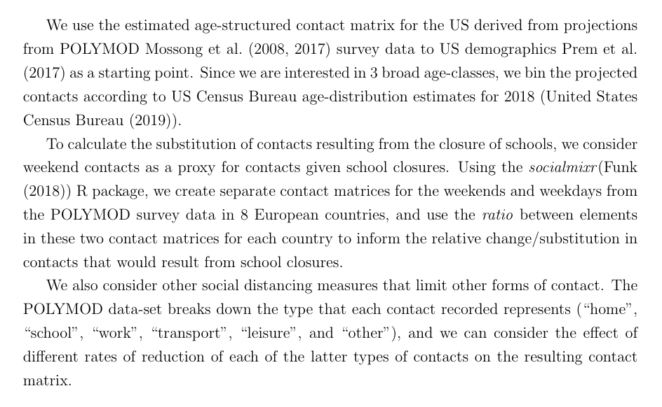
Contact rates by strata

Slide 10
Epidemiological parameters
Description | Base case | Range
basic reproductive number (R₀) | 2.2 | (1.5, 3.2)
relative rate of asymptomatic transmission | 0.375 | (.25, .5)
proportion of individuals < 20 that do not ever experience symptoms | 0.75 | (.5, .9)
proportion of individuals 20-64 that do not ever experience symptoms | 0.3 | (.2, .4)
proportion of individuals 65+ that do not ever experience symptoms | 0.3 | (.2, .4)
average length of pre-symptomatic infected period | 0.5
average length of incubation period | 5 days | (4-6)
average duration of infection | 5 days | (3-7)
case fatality rate (< 20) | 0
case fatality rate (20-64) | 0.005
case fatality rate (65+) | 0.1
percentage of cases observed at baseline | 0.13 | (4-30)
number of cases observed at baseline | 100 | calibrated
ratio of latent group to infected group at baseline | 1
relative testing rate of kids | 1
relative infectiousness of kids | 1 | (.5-1)
relative susceptibility of kids | 1 | (.5-1)

